Slide 1
PPrime®
PPrime- What is it?
An EHR ( Electronic Health Records) application.
A unique project initiated by eHealth LLC based in Saint Louis MO- USA.
Many unique features that are currently NOT available with other popular EHR applications (EPIC,CERNR).

Slide 2
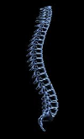
PPrime Business Landscape
PPrime application expected to be used in following lines of medical practices:
Family Physicians
Large Hospitals
Nursing Homes
Chiropractic

Slide 3
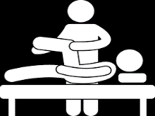
PPrime Business Landscape...Continue
PPrime application expected to be used in following lines of medical practices:
Ayurvedic Medicine
Homeopathic lines of medicines
Physiotherapy Centers
Other holistic body approach treatments practices.

Slide 4
Our Markets
Global Healthcare business is over $ 6.5 trillion ( US alone > $3 Trillion) with emphasis on moving towards all electronic. We are well positioned to tap that market especially outside USA where electronic health records (EHR) are at early stages of establishment.

Slide 6
Market Segment
Our current market segments identified:
USA ( all states, starting with Missouri)
India ( all states, with Unique* marketing)
Dhaka ( Bangladesh)
Doha (Qatar)
UAE
South Africa
Nigeria
Australia

Slide 7
Revenue Projection

Slide 8
Well Wishers & Sponsors
Dr. George Abraham – Asst. Professor UMKC- Medical Colleague.
Dr. Nanda Chief of Staff (Physicians) – SSM Hospitals
Dr. Saji Jacob MD-Robotic Surgeon.
Dr. James Abraham MD ( Pulmonary & Critical Care)
Dr. Susy Elias MD
Dr. Deepu Sudhakaran, MD MBA (Washington University) Bariatric Surgeon.
Dr. Chandrashekhar MD –Family Practitioner.
Dr. Kirubahara, Vaheesan SLU - Chief of Interventional Radiology.

Slide 9
PPrime Highlights
Other than standard features that is available across almost all EHR applications, PPrime provide following value added features:
Main highlight of PPrime application is the Patented feature and its ability to present a patient in a visual form and represent the prognosis with in the whole body.
Providing doctors/physicians a daily list “Dr. Daily List” with most intuitive way to their smart devices ( iPad, tablets, Smart phones)
PPrime “Patient Management Screen” has the most effective way of viewing and managing scheduled patients for any facility and take actions.

Slide 10
Highlights....Continue
Our PPrime Dashboard is professional looking, an impressive yet very useful feature for a business unit.
PPrime provide physicians and medical professionals to add their own custom graphs for tracking any important patient matrix
This PPrime application can be very will adaptive to multiple lines of practices ( like “Family Physicians”, “Big Hospitals”, “Nursing Homes”, Chiropractic, Ayurveda, Homeopathic lines of medicines, “Physiotherapy Centers” and other holistic body approach lines of business).

Slide 11
Highlights....Continue
This product architecture and issue tracking approach is very flexible enough and can be easily customized to track:
Process factory issues ( chemical and oil & gas)
Big equipment's ( airplanes, earthmoving equipment)
Global Market with trillions of dollars on Healthcare side along with our effective marketing model

Slide 12
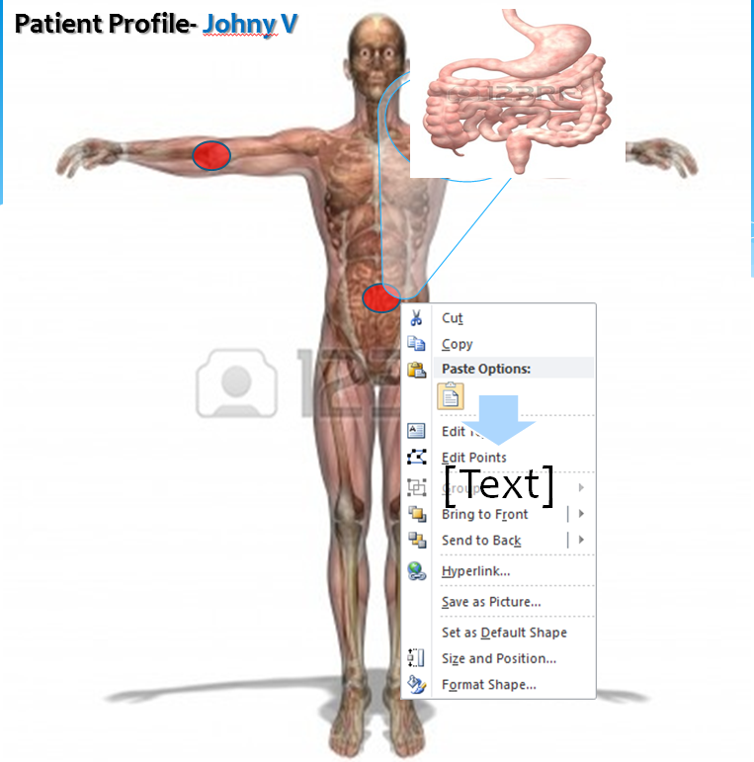
Our Patent Pending* Patient Profile Screen:
This patent pending, state of the art feature is very unique and not available elsewhere. This feature makes physicians to quickly understand a patient as a whole without spending time for reading the patient records saving lot of valuable time.

Slide 13
Our Patent Pending* Patient Profile Screen:- Continue..
Saving time for physicians
Understanding patient better.
Increasing the productivity of doctors.
Helps in making well informed better decision on encounters.
Saves money for business as a whole.
Physician time saved translate to money saved.
Quality prognosis makes satisfied patients and more popularity bring business.
Saves money on malpractice encounters .

Slide 14
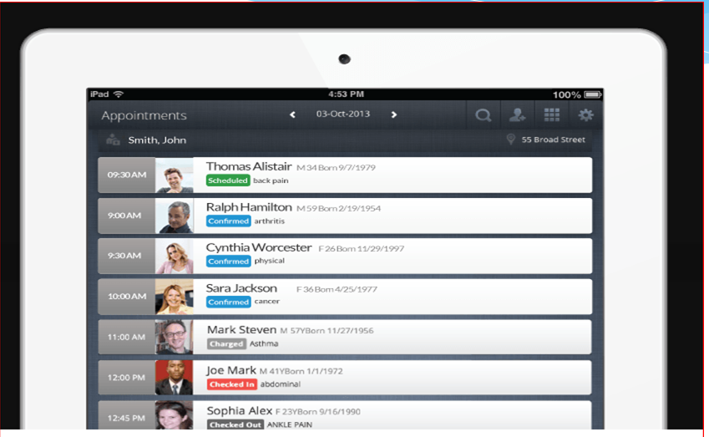
Dr. Daily List
This screen allow physicians to take a look at their daily patient list from their home devices very quick on a single click of a button.

Slide 15
Dr. Daily List-Cont..
This help the physicians to see quickly his/her schedule, understand work load and get information about the patients at a glance.
If needed physicians can drill down further to see patient “Profile Screen*”
The list enable a busy physician to understand patient while physicians are even “On The Move”
Enable physicians to manage his/her day lot better.

Slide 16
Patient Management Screen
This screen is designed to help office/facility to better manage the patients by the office staff. This feature resolves an existing gap in many commercially available applications currently.

Slide 17
Patient Management Screen—Cont..
Office staff can see a comprehensive patient list for any facility that is scheduled to a visit order by date and time.
Staff can sent text, email, and call & communicate with patient right from this very screen.
Office staff can even filter by different fields to enable to get to any patient records easily.
Staff can even take actions like postpone and update the schedules/encounters from this screen.
Speed-up the office work and productivity.

Slide 18
PPrime Dashboard
This is very professional looking Dashboard enable to see “Health” of the business unit as a whole.
Ability to track different matrix for the business.
Identify action area and items easily.
Ability to drilldown and see the root cause.
Identify application health issues if any.
Drill down to produce different analysis graphs.
Alert the milestone dates for the business.
Business License Expiry Due In: -- days
Physician Certification Expiry Due In: -- days
Nurse Certification Expiry Due In: --- days
Technician Certification Expiry Due In: ---days
Inspection Date Due In: --- days

Slide 19
Our Custom Graphing
Current applications mostly provide with standard graphing feature and most of them are not relevant for a particulate patient. This feature provide physicians to add matrix and graphs they wanted to track for a particular patient and for a particular context.
Since this is customized to a patient, managing the treatment progress and its effectiveness is highly visual and apparent.

Slide 20
Future Lines Of Business
This product architecture and issue tracking approach is very flexible enough and can be easily customized to other lines of business.
Process factory issues ( chemical and oil & gas)
Track big equipment's issues ( airplanes, earthmoving equipment)

Slide 21
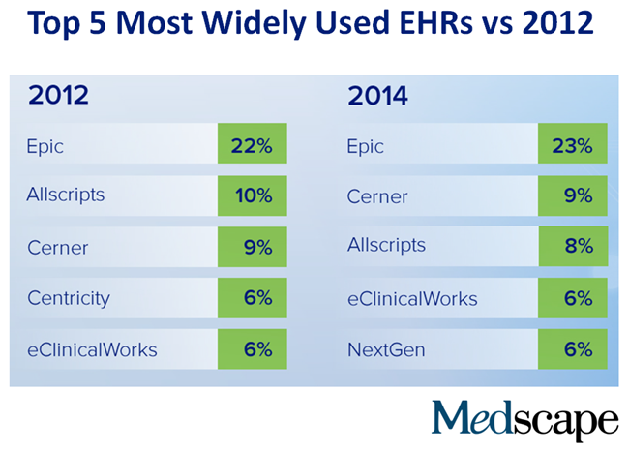
EHR Market Share

